Slide 1

Efficient tools and techniques for modern software development
Visual Studio Code
Vineel Kovvuri
Senior SDE @ Microsoft

Slide 2

Agenda
IDE vs Text Editor – Why VS Code?
Installation/Opening
Basic Editing/Navigation Tricks
The Editor
Multiple Cursors
Extensions
References

Slide 3
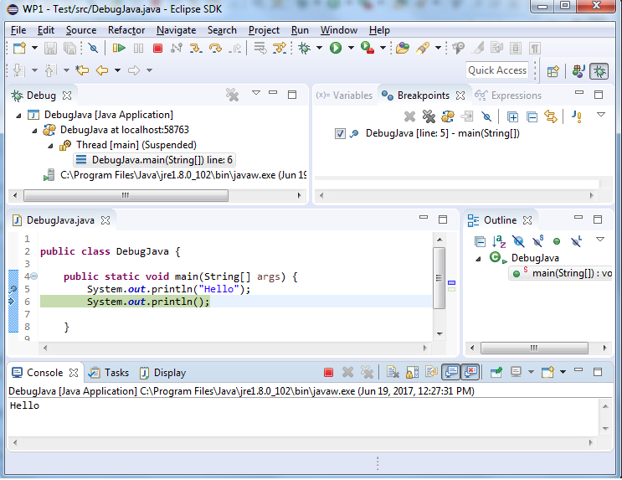
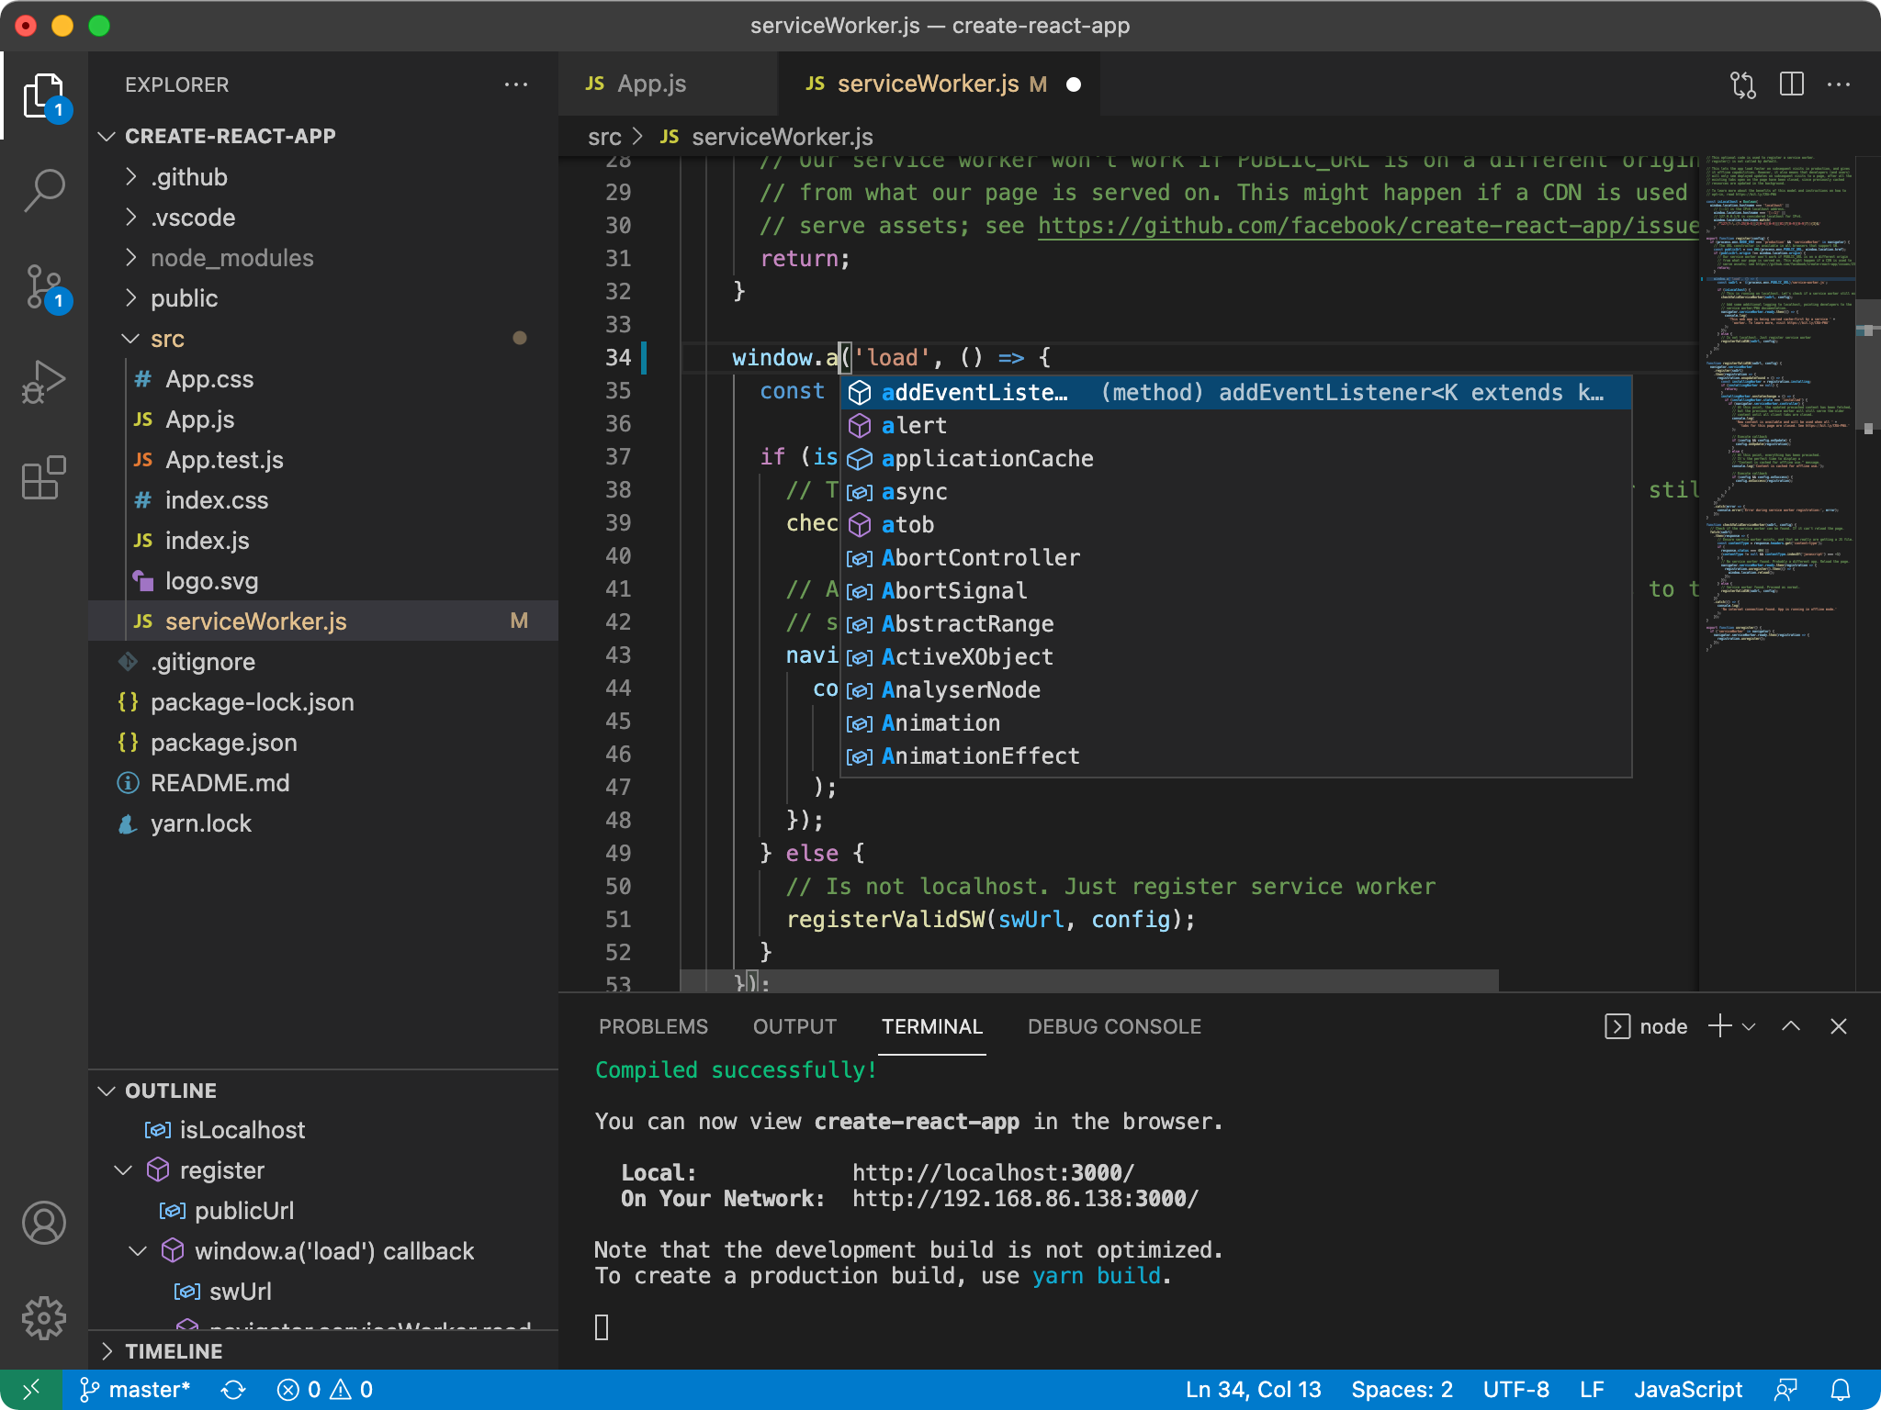
IDE vs Text Editor – Why VS Code?
IDE(Integrated Development Environment) – Eclispe/Netbeans/Intellij/Visual Studio*
Pros:
They include compilers and integrated tools to build end to end projects
Cons:
Big in size(around few GBs)
Cannot handle large projects
Usually Paid and not free/open source
Text Editors – Visual Studio Code/Vim/Emacs
Pros:
Light weight(around few MBs).
Can handle large code bases and very flexible to customize
Open source and free of cost
Cons:
Do not include compilers/debuggers.
Building end to end projects require working with build systems separately.
Please do not use Notepad/Notepad++😁
*Visual Studio is different from Visual Studio Code

Slide 4
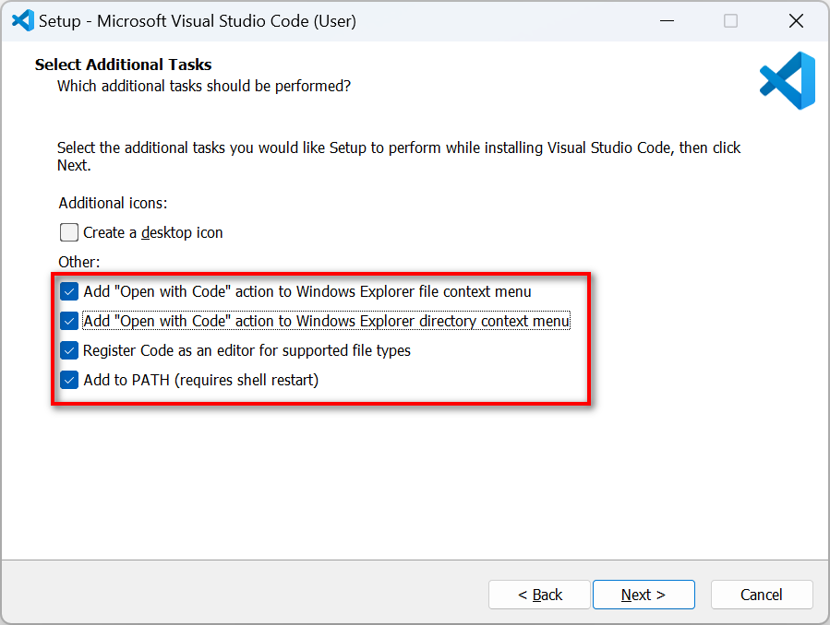
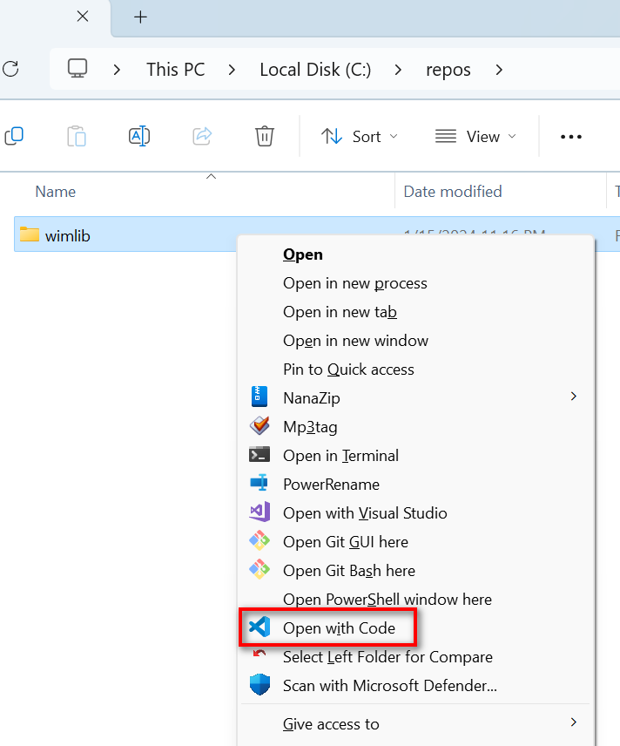
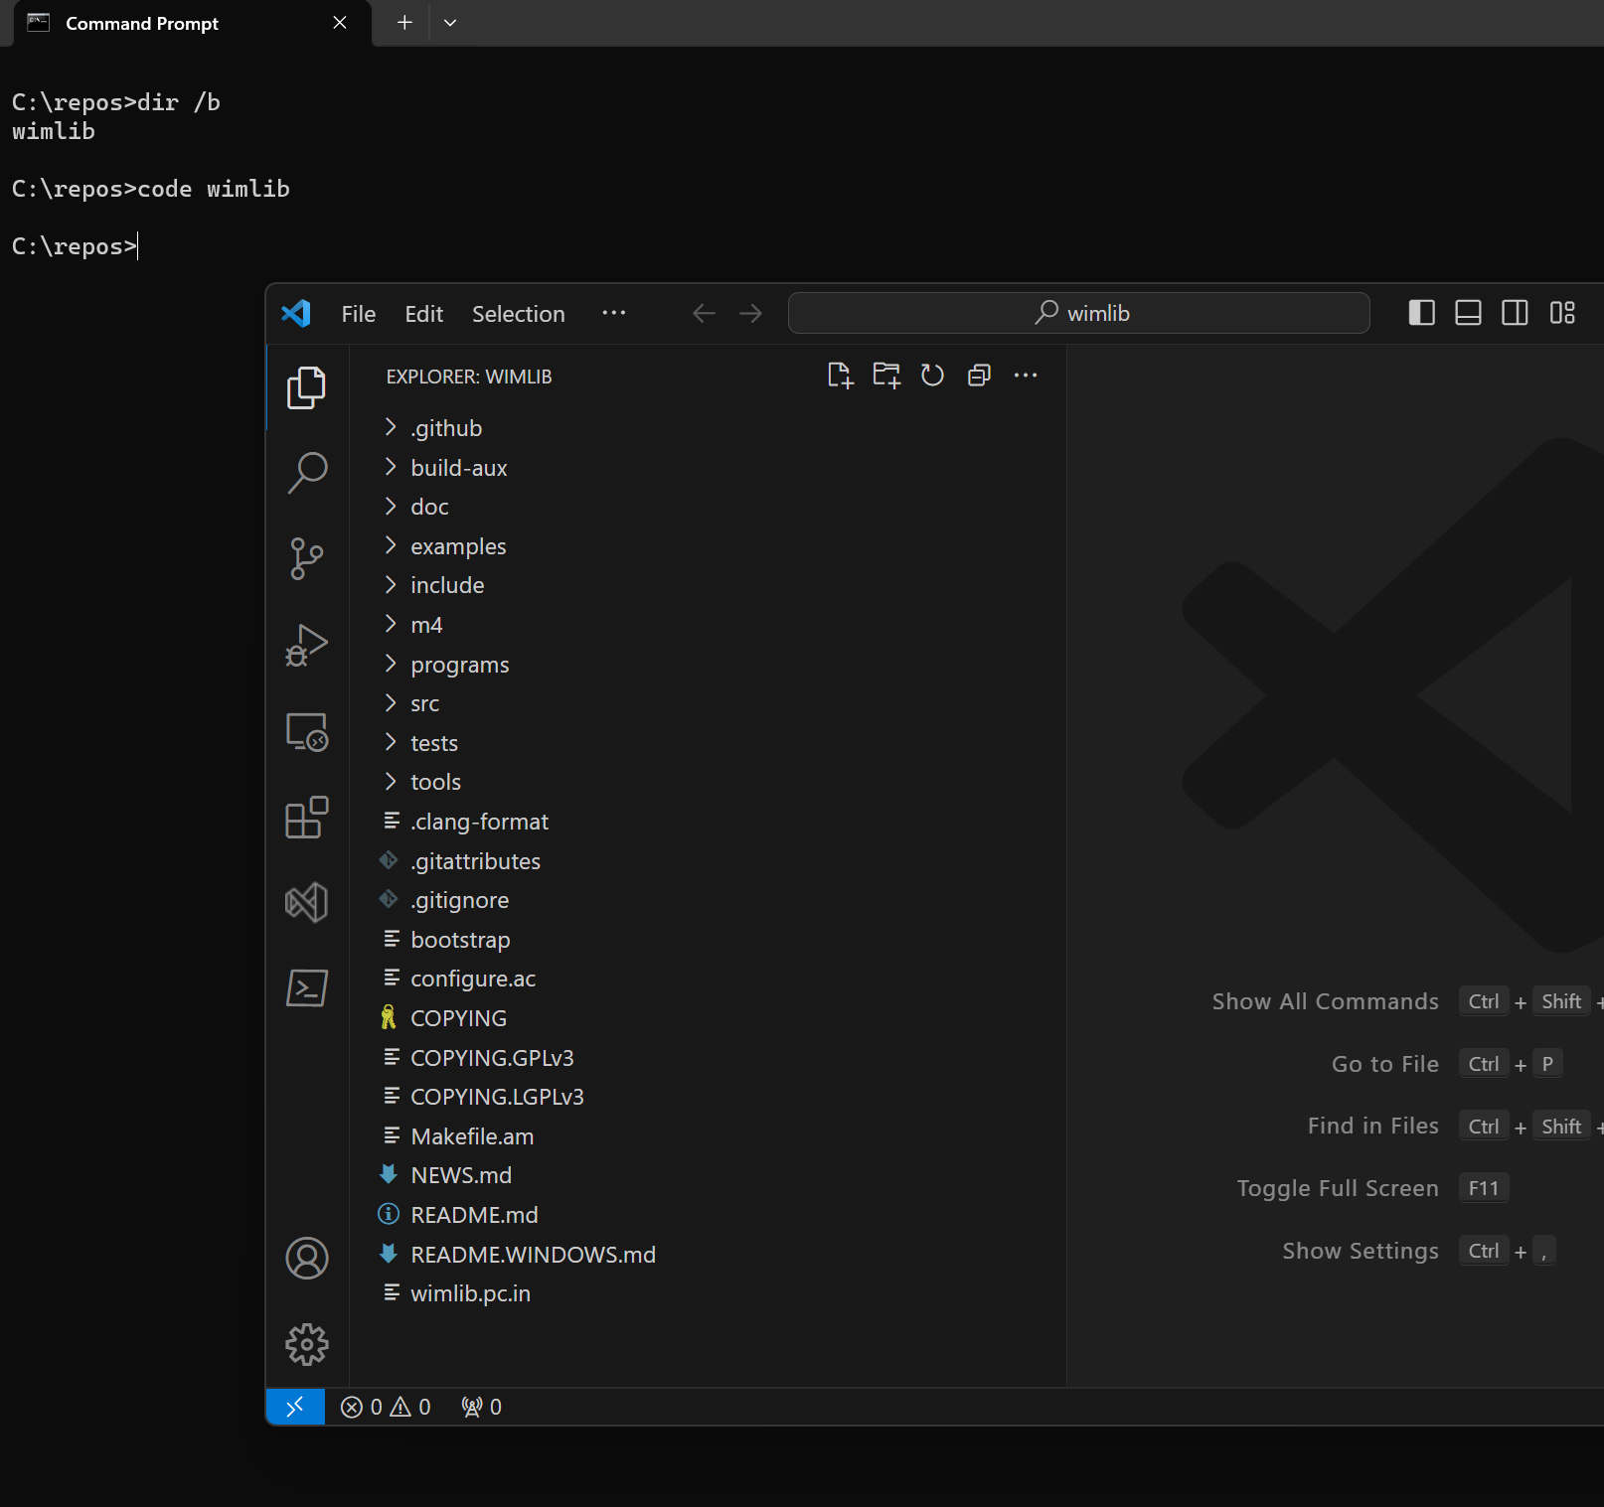

Installation/Opening
Via Explorer Context Menu
Via Command Line – Code.exe
Open single file vs folder
https://code.visualstudio.com/download

Slide 5
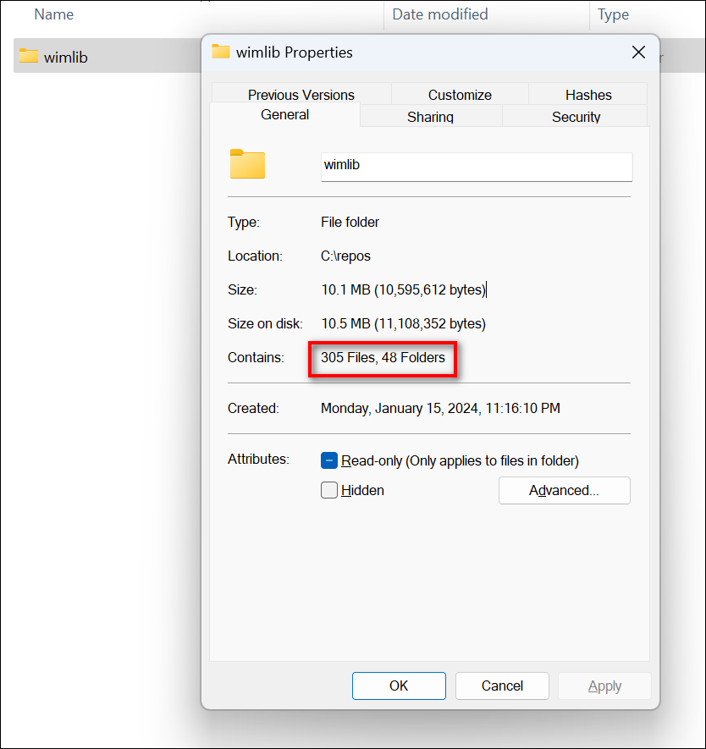
The Editor Overview
Ctrl + Shift + P – Open Command Palette
Ctrl + P –Open File from workspace(?)
Explorer
Create files with multiple sub directories deep
Compare Files
Editor tabs – Copy Path
80/100 Column Guides
Indent Guides
Ctrl + F/H – Find/Replace in current file
Scroll bar search highlights
Ctrl + Shift + F/H – Find/Replace in workspace
Ctrl + \ - Splits
Sticky Scroll
Ctrl + Shift + \ - Find the matching brace
Alt + Left/Right – Navigation history
Remove blank lines

Slide 6
Basic Editing/Navigation in editing text
Left/Right – navigate each character left/right
Ctrl – Jump b/w words
Home/End – Move to beginning and end of the line
Shift – Selection character
Delete/Backspace – deletes the next/previous character
Ctrl+C – Copy selected text
Ctrl+V – Paste copied text
Ctrl+X – Cut selected text
VS Code Specific
Line Operations(no selection)
Ctrl + C – Copy entire line
Ctrl + X – Cut Line
Alt + Down/Up – Move lines

Slide 7
Basic editing walkthrough

Slide 8
Multiple Cursor
Ctrl + D – Create Multiple cursor at next occurrence
Ctrl + Alt + Down/Up – Create Multiple cursors on each line
Each Cursors copies its own select word
Ctrl + Shift + I – Multiple Cursors on all selected lines
Ctrl+F > Search > Alt+Enter – Create multiple cursor on all occurrences in the current file

Slide 9
Multiple Cursors Walkthrough

Slide 10
Extensions
Align
Case conversion(Transform)
Text Pastry - 1 to X
Delete trailing spaces
Commenting flow
Prettier – Code formatter – Shift + Alt + F
VSCode-PDF extension
Rainbow CSV extension

Slide 11
Extensions Walkthrough

Slide 12
References
https://github.com/vineelkovvuri/gvpcoe-sessions-2024/blob/master/VSCode
https://stackoverflow.com/
https://www.youtube.com/@code/shorts
https://code.visualstudio.com/docs

Slide 13



Thank You
Vineel.Kovvuri@gmail.com
https://github.com/vineelkovvuri
https://www.linkedin.com/in/vineelkovvuri

Slide 14
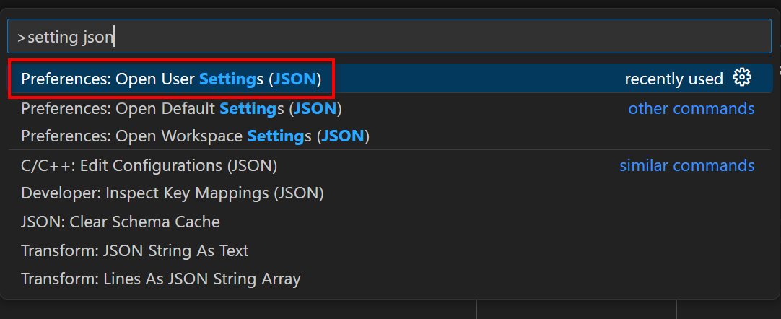
Settings and Customization
My Settings/Extensions List
https://github.com/vineelkovvuri/gvpcoe-sessions-2024/blob/master/VSCode/Session/5.VSCode_Settings/settings.json
https://github.com/vineelkovvuri/gvpcoe-sessions-2024/blob/master/VSCode/Session/5.VSCode_Settings/extensions_lists.txt

